Slide 1
Bayesian Regression in Stan
Steve Wood

Slide 2
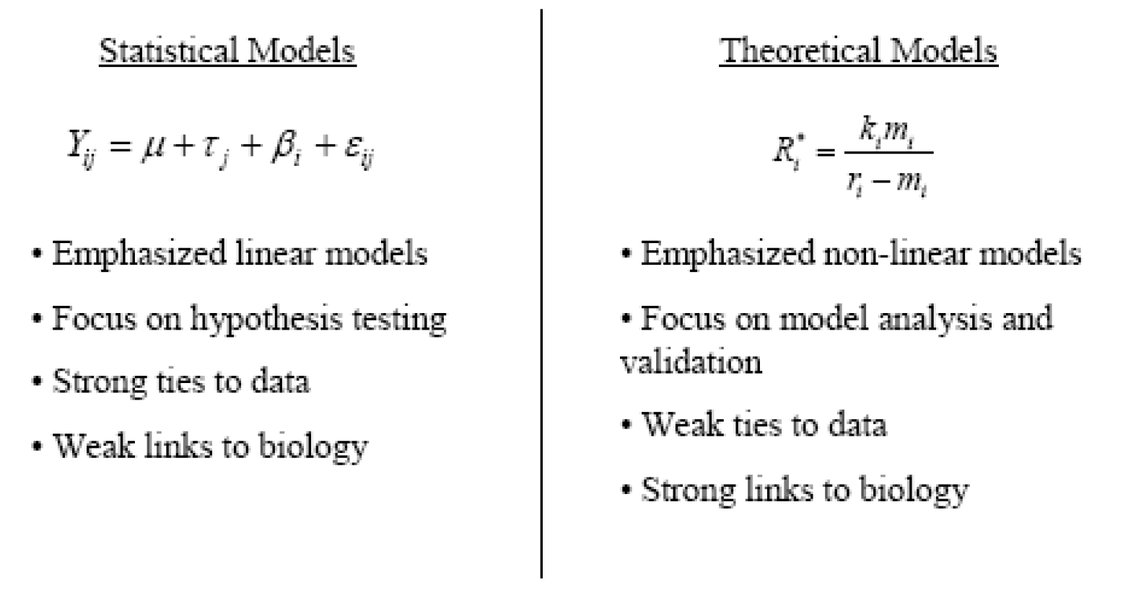
Distinction in ecological models

Slide 3
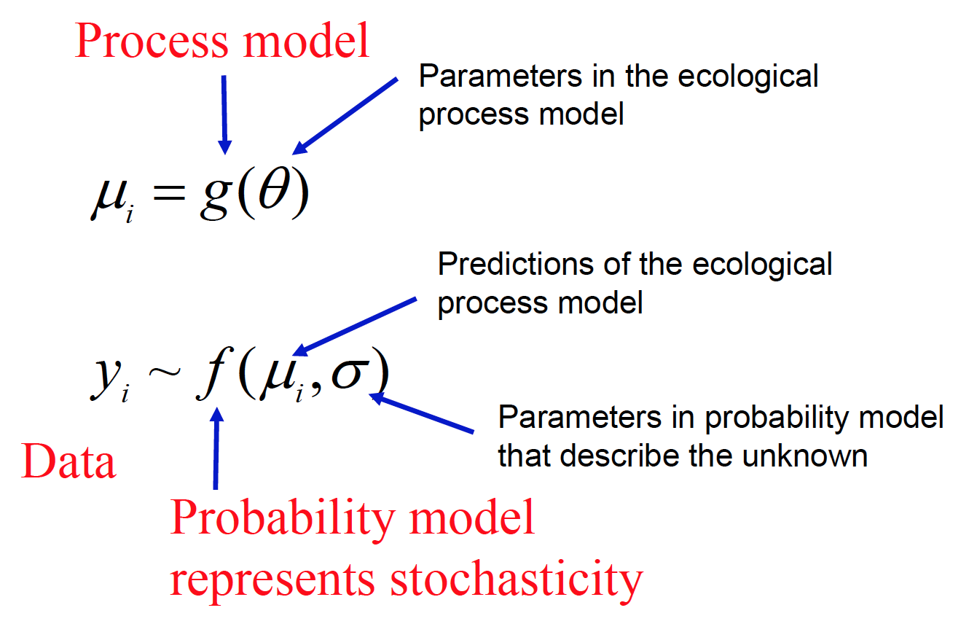
How do we represent unknowns?

Slide 4
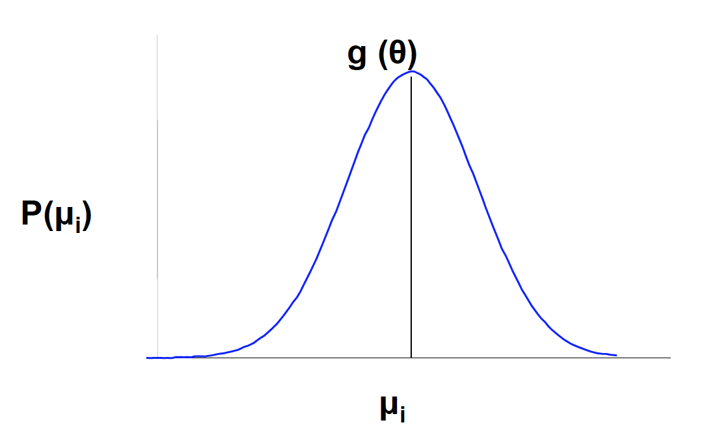
Stochastic models
In contrast to deterministic models that predict a scalar for any input, stochastic models predict probability distributions of values.

Slide 5
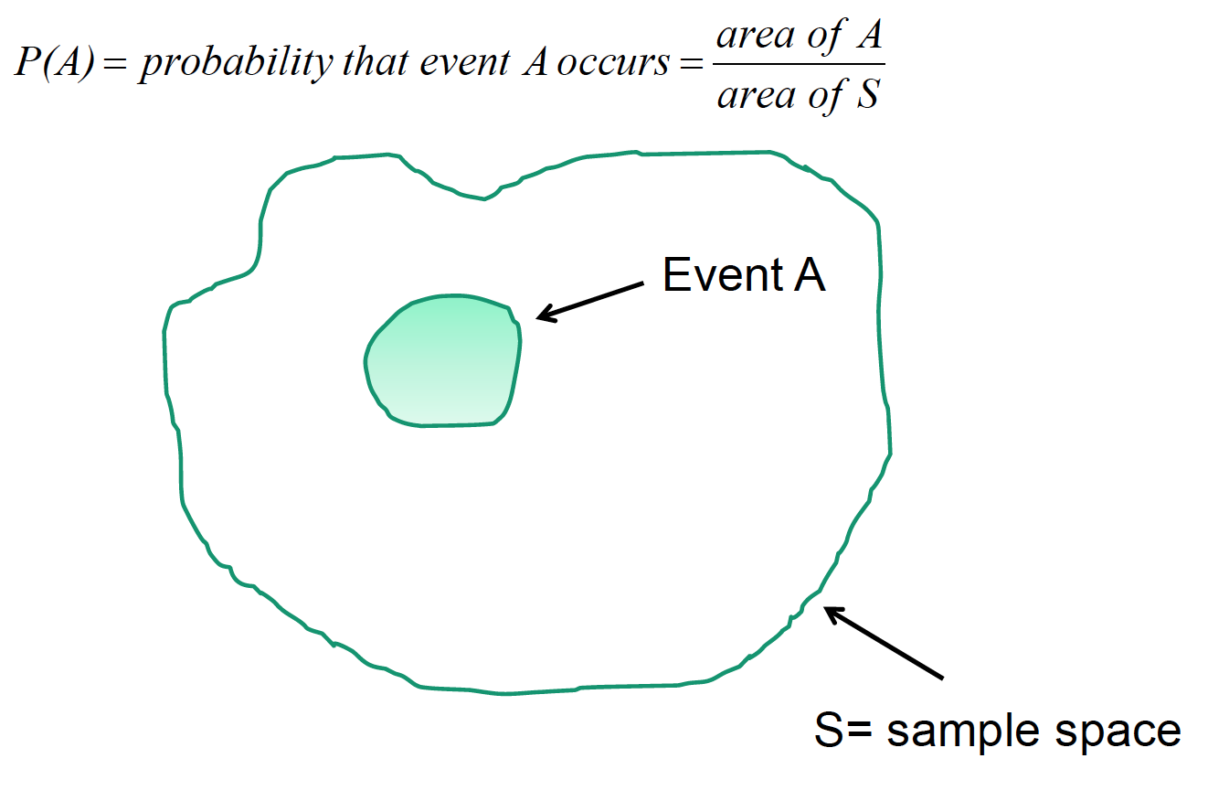
Concept of probability

Slide 6
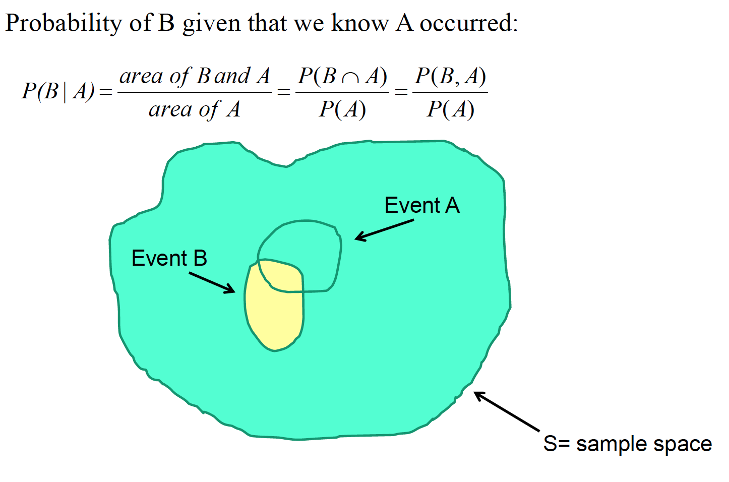
Conditional probabilities

Slide 7
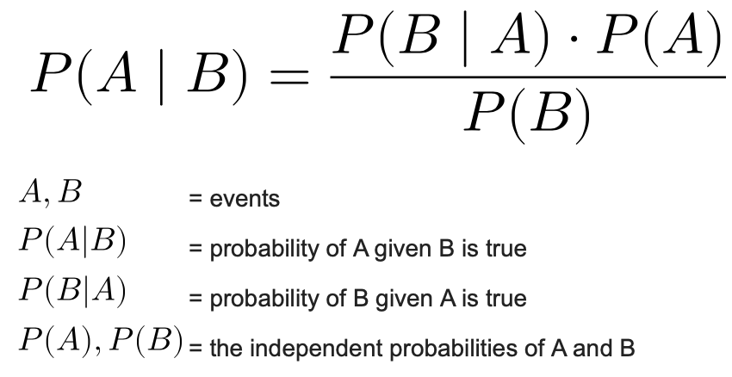
What is Bayes’ Theorem?

Slide 8
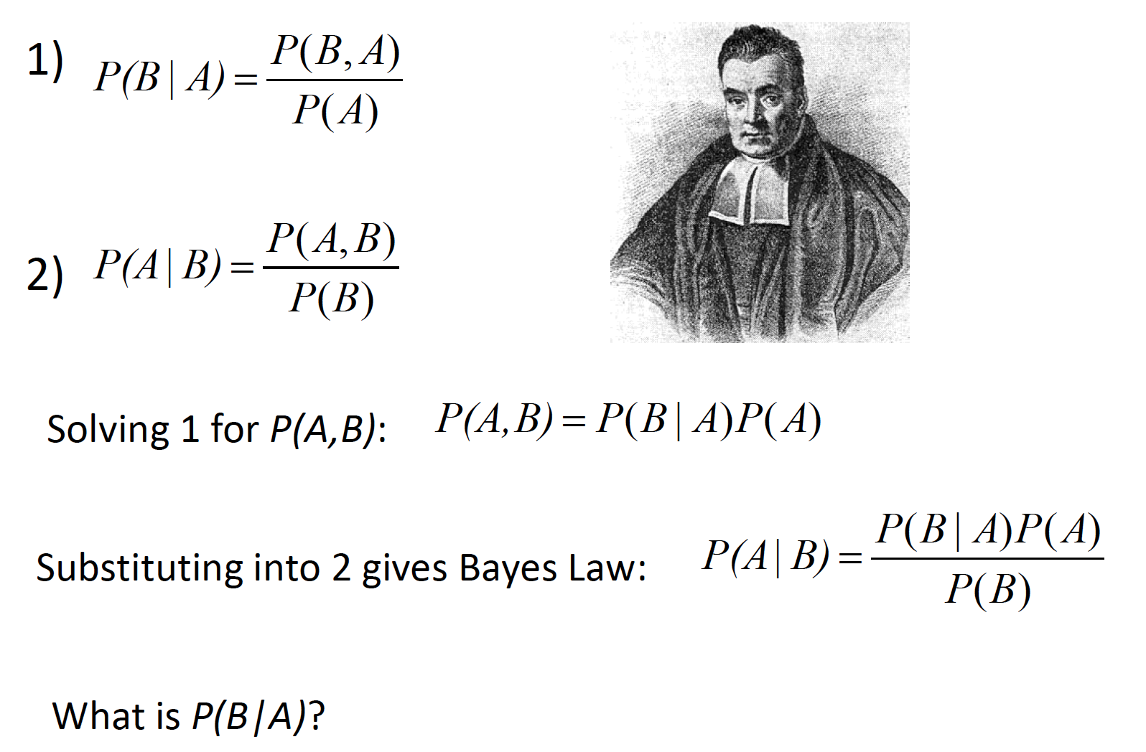
Deriving Bayes’ law

Slide 9
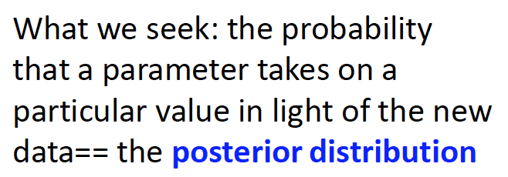
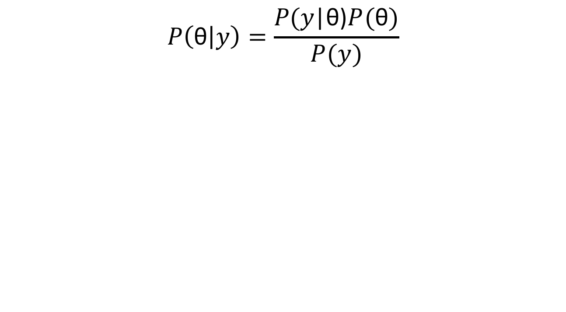
Applying Bayes to statistics
Do you recognize this?
$$P\left(\text{θ} | y\right)=\frac{P\text{(}y\text{|}\text{θ}\text{)}P(\text{θ})}{P(y)}$$

Slide 10
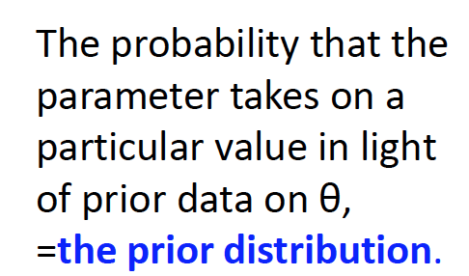
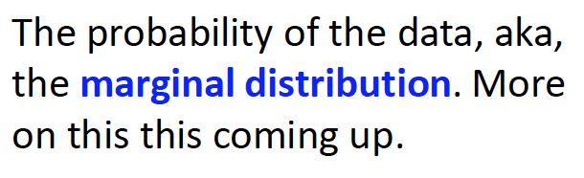
Applying Bayes to statistics
The probability of observing the data given the parameter==the likelihood
$$P\left(\text{θ} | y\right)=\frac{P\text{(}y\text{|}\text{θ}\text{)}P(\text{θ})}{P(y)}$$

Slide 11
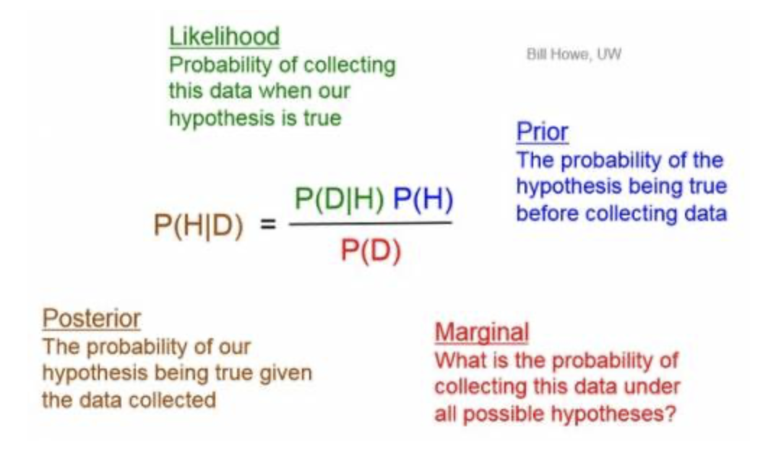
How does Bayes’ Theorem apply to stats?
Maximum Likelihood Estimation
Bayesian Estimation

Slide 12
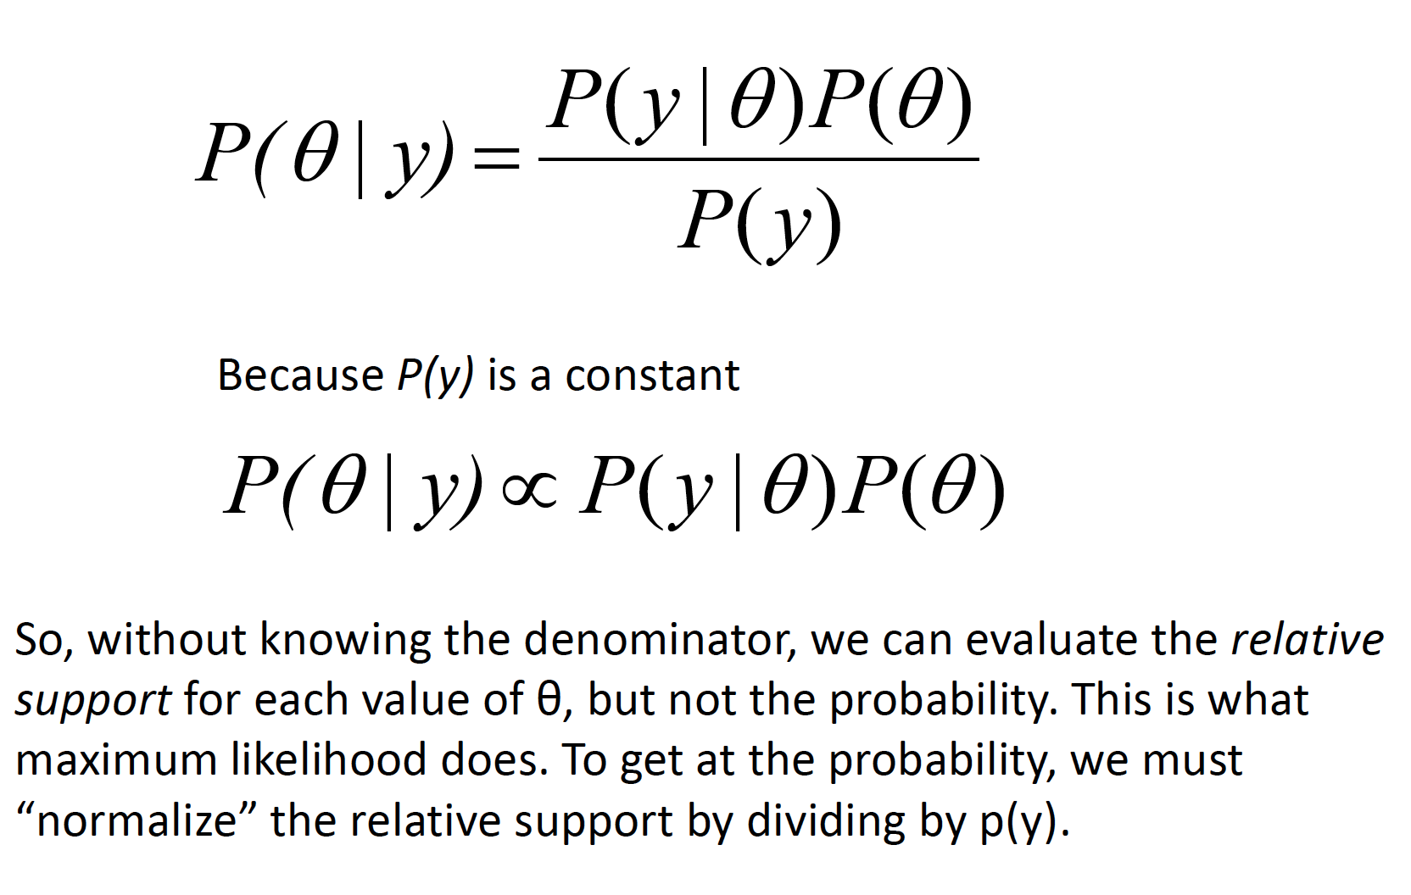
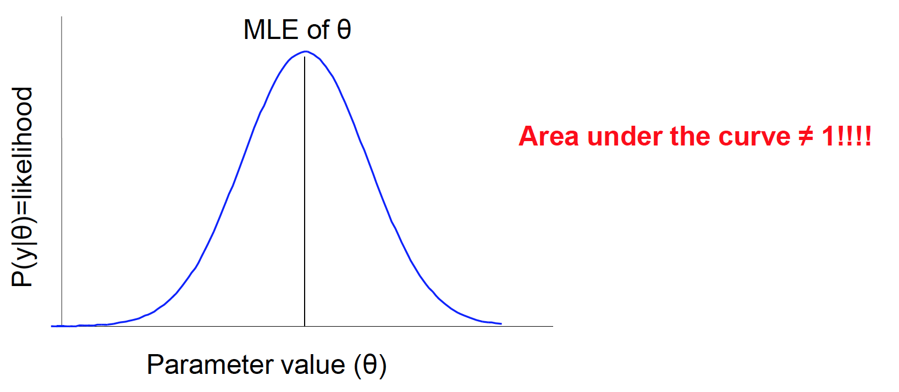
What is P(y)?
Notes:
Because likelihood is only proportional to probability, likelihood values don’t make objective sense; they’re only useful relative to other models
Because of this “objectivity” of Bayesian probability vis-à-vis likelihood, what we learn from our current study informs the prior in subsequent studies.
In Bayes, we integrate over the entire range of parameter values to get a PDF by dividing each point on the “likelihood profile” by the area beneath the profile. The estimate of our parameter is the mean of the resulting PDF. We also obtain estimates of the median, variance, kurtosis, etc..., which allows us to make statements about the probability of our parameter(s). Likelihood cannot make these statements.

Slide 13
Why is Bayes considered “modern”?
Thomas Bayes: 1701-1761
RA Fisher: 1890-1962

Slide 14
Why is Bayes considered “modern”?

Slide 15
So, how do we get P(y)?
We can rarely solve P(y) analytically, so we need to simulate it
Statisticians knew how to do this for a long time, but it was computationally intensive before modern computing
Here are some terms you may have heard of that that all have to do with simulating P(y):
Markov Chain Monte Carlo
Metropolis-Hastings
Gibbs Sampling (BUGS, JAGS)
Hamiltonian Monte Carlo (Stan)
No-U-Turn Sampler

Slide 16
What is Stan?
Statistical software that estimates parameters with Hamiltonian Monte Carlo sampling, specifically the No-U-Turn Sampler
Developed by Andrew Gelman and team at Columbia
This is a sampler that is much more efficient than the Gibbs sampler for high dimensional problems
The difference between Stan, Bugs, and Jags is negligible for simple problems

Slide 17
Simple linear regression
y ~ Normal(mu, sigma)
mu = alpha + beta * x

Slide 18
Setting priors
P(y|beta) ~ P(beta|y) * P(beta) / P(y)
beta ~ Normal(mu_beta, sigma_beta)
Priors: we tell Stan what mu_beta and sigma_beta are (maybe from previous studies)
Weakly informative prior: beta ~ Normal(0,10)
Usually we have more information than this!

Slide 19
Setting priors
Mu_beta is a hyperparameter aka a parameter of a parameter
We can keep modeling more hyperparameters
Ex: mu_beta ~ normal(tau, rho)

Slide 20
Generalized models
Y ~ lognormal(mu, sigma)
mu = alpha + beta * x
Y ~ poisson(lambda)
lambda = alpha + beta*x
Etc…

Slide 21
Multiple regression
y ~ Normal(mu, sigma)
mu = alpha + B * X

Slide 22
Random effects
lmer(y~x1+ (1|x2))
What is (1|x2)?

Slide 23
Random effects
y ~ Normal(mu, sigma)
mu = alpha_{j} + B * X
j = # of intercepts you want

Slide 24
Measurement error (in x)
Usually we don’t know the “true” values of y or x
”measurement” error can come from instrument error, human lab variability, field variability etc.
With the right information you could quantify the magnitude of all of these errors and figure out where to focus your measurements to best reduce error

Slide 25
Other cool stuff
Time-series models
Process-based models
Forecasting models
Mark-recapture models
Clustering models (k-means)

Slide 26
Further Resources
Books
McElreath, Statistical Rethinking
Gelman & Hill
Gelman et al 2013
Online Resources
Stan User’s Guide
Stan Forum

